Slide 1
NOFILE Enquiries in T24
Notes:
Welcome to the “NOFILE Enquiries in T24” learning unit. This learning unit will enable you to understand the use of Nofile Enquiries in T24. You will also learn how to create and execute Nofile enquiries.

Slide 2
Objectives
After completing this learning unit/course, you will be able to:
Understand the need for Nofile Enquiries
Create Nofile Enquiries in T24
Execute a Nofile enquiry
Notes:
After completing this learning unit/course, you will be able to:
Understand the need for Nofile Enquiries
Create Nofile Enquiries in T24
Execute a Nofile enquiry
PRG7-Nofile Enquiry-R12

Slide 3
What is an Enquiry in T24
An ENQUIRY is used to extract data from an application
ENQUIRY can also be used to extract data by linking multiple applications
Notes:
The ENQUIRY application in T24 is used to extract data from a single application and display it in a user defined format.
By default an enquiry can extract and display data from only one application but the CONVERSION field allows a small loop hole using which data from other applications can be displayed. This field can be used to link to applications whose ID is part of the data to be displayed in the enquiry. This will make sense with an example.
PRG7-Nofile Enquiry-R12

Slide 4
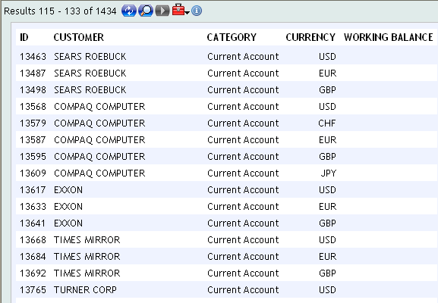
Task - ENQUIRY
Notes:
If you take a look at the enquiry screen shot, not all the data displayed is available in a single application. The base application to create this enquiry is ACCOUNT. However, data needs to be extracted from the applications CATEGORY and CUSTOMER as well. If you open an account record, you will notice that the ID of both customer and category are a part of it. In such a scenario, you can use the CONVERSION field in the ENQUIRY application by linking other applications to display the required data.
PRG7-Nofile Enquiry-R12

Slide 5
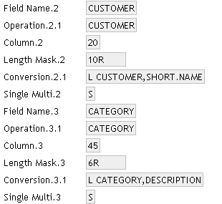
Task – Creating the Enquiry
Notes:
The syntax to link applications is ‘L <application name>,<field name>’. L denotes linking of the applications. Field name should be a valid name as per the STANDARD.SELECTION whose value needs to be extracted and displayed in the enquiry.
PRG7-Nofile Enquiry-R12

Slide 6
No One File
What if there are multiple files involved in creation of an enquiry?
What if the record ID of another application is not part of the base application?
This can be achieved using Nofile enquiries
Notes:
1. If there are multiple files involved in an enquiry, and if the ID of a record of another application is part of the base application, then you can use the CONVERSION field to display the data required.
2. What if you require data that cannot be obtained using the CONVERSION field? What if the ID of a record from an application, whose data needs to be extracted for an enquiry is not part of the base application? What if there are multiple such applications involved?
3. In such a scenario, where there is no one file or application is enough to create an enquiry, you have to create a Nofile enquiry.
PRG7-Nofile Enquiry-R12

Slide 7
NOFILE Enquiry
Since more than one file might be required to extract data from, it is a Nofile enquiry
Nofile enquiry can extract data from any number of T24 applications
Subroutine to extract all the data required
ENQUIRY application is used to display extracted data
Notes:
1. Why are these enquiries called Nofile enquiries? There is no single file attached to the enquiry to extract data from and hence they are named as Nofile enquiries.
2. Using a Nofile enquiry, you can extract data from any number of T24 applications and display the results in a user defined format.
3. A Nofile enquiry involves a subroutine to be written in order to extract the required data from different applications.
4. Its vital to remember that you will still use the ENQUIRY application to display the extracted data in user defined format.
PRG7-Nofile Enquiry-R12

Slide 8
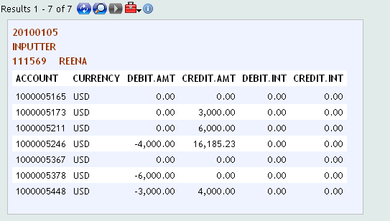
Task
Notes:
You will now learn how to create a Nofile enquiry using an example. The final required output is what is displayed in this screen shot above.
The report is customer specific. The details of the customer is displayed in the Header of the output. The column ACCOUNT should display all the account numbers belonging to a particular customer for who the enquiry is executed. The CURRENCY column should display the currency of the concerned account. The DEBIT.AMT column should display the total of the forward debit movements which is the money that the customer is liable to pay at a future date. The CREDIT.AMT column should display the total of the forward credit movements which is the money that is due to the customer at a future date. The DEBIT.INT column should display the total accrued interest that the customer is liable to pay. The CREDIT.INT column should display the total accrued interest that is due to the customer.
From this output, you can see that all this data is not available in one application but in multiple. In the next few slides you will learn which applications must be accessed to get all this information from. The first step in creating a Nofile enquiry is to write the jBASE BASIC routine to extract the required data.
PRG7-Nofile Enquiry-R12

Slide 9
Data Required?
CUSTOMER.ACCOUNT
For a given Customer – All ACCOUNTS
For each Account
Currency
Forward Debits
Forward Credits
Accrued Interest Liable
Accrued Interest Receivable
ACCOUNT
ACCT.ENT.FWD -> STMT.ENTRY
ACCT.ENT.FWD -> STMT.ENTRY
ACCR.ACCT.DR
ACCR.ACCT.CR
Notes:
This slide lists the details that need to be displayed. It also shows you the T24 CONCAT / LIVE Files or Application names that must be accessed in order to do so.
In the next few slides, you will see the contents of each of these applications and understand how to extract the required data from them.
PRG7-Nofile Enquiry-R12

Slide 10
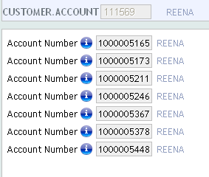
Solution – CUSTOMER.ACCOUNT
CUSTOMER – User Input
CUSTOMER.ACCOUNT
All ACCOUNTS
Notes:
As per the task given to you, the user should input a customer number based on which the desired output is to be displayed. To get a list of accounts per customer, T24 maintains a CONCAT file called CUSTOMER.ACCOUNT. The ID of this is the Customer ID while the record contains all Account ID’s that belong to him. So this is your first step is gathering the data to be displayed.
Note: Technically each account is separated by an FM when a record is read from the CUSTOMER.ACCOUNT CONCAT file.
PRG7-Nofile Enquiry-R12

Slide 11
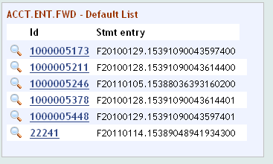
Solution – ACCT.ENT.FWD
CUSTOMER – User Input
CUSTOMER.ACCOUNT
All ACCOUNTS
With ACCOUNT read
ACCT.ENT.FWD
Get STMT.ENTRY ID’s
Notes:
The next application that needs to be accessed is ACCT.ENT.FWD for a particular account belonging to the customer. This is a Live file and contains forward STMT.ENTRY Ids for an account, which will affect an account at a future date. The ID of a record in this application is the account number. These STMT.ENTRY ID’s will be used to pick up the debit or credit amount from the STMT.ENTRY application and displayed in the DEBIT or CREDIT columns in the enquiry output respectively.
PRG7-Nofile Enquiry-R12

Slide 12
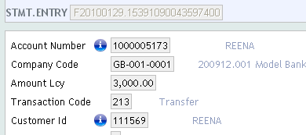
Solution – STMT.ENTRY
CUSTOMER – User Input
CUSTOMER.ACCOUNT
All ACCOUNTS
With ACCOUNT read
ACCT.ENT.FWD
Get STMT.ENTRY ID’s
From STMT.ENTRY, -ve
Amount is a fwd debit
From STMT.ENTRY, +ve
Amount is a fwd credit
Notes:
If you don’t already know, STMT.ENTRY is a Live file. If the value in the field AMOUNT.LCY is negative, then it counts up to the column DEBIT.AMT and if the value is positive, then it counts up to CREDIT.AMT column in the enquiry output.
PRG7-Nofile Enquiry-R12

Slide 13
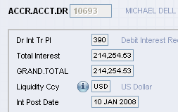

Solution – ACCR.ACCT.DR and ACCR.ACCT.CR
CUSTOMER – User Input
CUSTOMER.ACCOUNT
All ACCOUNTS
With ACCOUNT read
ACCT.ENT.FWD
Get STMT.ENTRY ID’s
From STMT.ENTRY, -ve
Amount is a fwd debit
Read ACCR.ACCT.DR
Read ACCR.ACCT.CR
From STMT.ENTRY, +ve
Amount is a fwd credit
Notes:
ACCR.ACCT.DR and ACCR.ACCT.CR are Live files which holds the total accrued debit and credit interest for an account. The ID of a record in this application is account number. The field TOTAL.INTEREST will hold the accrued debit or credit interest which can be picked up to fill the values in DEBIT.INT and CREDIT.INT columns in the enquiry output. If for an account, there is no debit or credit interest, then there exists no record in the particular application.
PRG7-Nofile Enquiry-R12

Slide 14
Solution - Algorithm
User inputs a CUSTOMER ID
Opens the respective record in CUSTOMER.ACCOUNT application
Loop for each account and open ACCT.ENT.FWD to get the STMT.ENTRY IDs
Pick up the value in the field AMOUNT.LCY from STMT.ENTRY application
Notes:
User should input a CUSTOMER ID
Once the CUSTOMER ID is entered, the respective record in CUSTOMER.ACCOUNT application should be read to get the list of accounts, which form the values for the column ACCOUNT in the enquiry report.
Loop for each account and read ACCT.ENT.FWD which will contain forward STMT.ENTRY ID’s.
Read STMT.ENTRY application with the ID’s got from ACCT.ENT.FWD and pick up the transaction amount and add it up to the respective columns in the enquiry report. If the amount is positive, add it up to the column CREDIT.AMT and if negative add it up to DEBIT.AMT in the enquiry report.
PRG7-Nofile Enquiry-R12

Slide 15
Solution - Algorithm
Read ACCR.ACCT.DR and ACCR.ACCT.CR and pick up value from the field TOTAL.INTEREST
Store data before repeating the loop for next account
The subroutine must contain a ‘return’ variable to pass the data to ENQUIRY application
Notes:
Read ACCR.ACCT.DR and ACCR.ACCT.CR with ID as account number and pick up value from the field TOTAL.INTEREST to fill in the columns DEBIT.AMT and CREDIT.AMT in the enquiry report.
Store all the data extracted before repeating the loop for next account.
After gathering all the required data to be displayed, you should ensure that the routine must have a ‘return’ variable to pass the data to the ENQUIRY application.
PRG7-Nofile Enquiry-R12

Slide 16
jBASE Basic Code
To access the customer number input by the user, use the common variables in I_ENQUIRY.COMMON
D.FIELDS – For fields available in the selection criteria window
D.LOGICAL.OPERANDS – Operands entered
D.RANGE.AND.VALUE – Value entered by user
All these common variables are dynamic arrays
D.FIELDS<1> = CUSTOMER.ID
D.LOGICAL.OPERANDS<1> = EQ
D.RANGE.AND.VALUE<1> = 1234
FIELD.NAME | OPERAND | VALUE
CUSTOMER.ID | EQ | 1234
Notes:
This task requires user input in the form of a CUSTOMER number when the enquiry is executed. How to add this field to the dynamic selection criteria box of the enquiry you will understand later in the unit. Since the routine is being discussed, you will now learn how to access this dynamic selection criteria within your code.
To access the data input by the user, you can use some common variables that are defined in I_ENQUIRY.COMMON.
1.1 D.FIELDS is the common variable which is used to hold the fields available in the selection criteria box.
1.2 D.LOGICAL.OPERANDS holds the operands used in the selection box.
1.3 D.RANGE.AND.VALUE holds the values entered by the user in the selection box.
2. All these common variables are dynamic arrays.
PRG7-Nofile Enquiry-R12

Slide 17
Solution - jBASE Basic Code
*SUBROUTINE TO WRITE A NOFILE ENQUIRY
SUBROUTINE TEST.NOFILE(AC.DETAILS)
$INSERT I_COMMON
$INSERT I_EQUATE
$INSERT I_F.CUSTOMER.ACCOUNT
$INSERT I_F.STMT.ENTRY
$INSERT I_F.ACCR.ACCT.CR
$INSERT I_F.ACCR.ACCT.DR
$INSERT I_ENQUIRY.COMMON
GOSUB INIT
GOSUB OPENFILES
GOSUB PROCESS
RETURN
Notes:
As a first step in writing code, you must add all the required insert files of the applications that will be used to extract data so that the field values can be used. Note that the Nofile enquiry routine will take one outgoing argument .
PRG7-Nofile Enquiry-R12

Slide 18
Solution - jBASE Basic Code
INIT:
NO.OF.REC = ''
SEL.LIST = ''
AC.ID = '‘
DR.AMT = ''
CR.AMT = ''
CR.INT = ''
DR.INT = ''
AC.DETAILS = ''
ST.ID = ''
R.FWD = ''
R.ST = ''
FWD.POS = ''
C.ID = ’’
AC.ID = '‘
RETURN
OPENFILES:
FN.CA = 'F.CUSTOMER.ACCOUNT'
F.CA = '‘
CALL OPF(FN.CA,F.CA)
FN.FWD = 'F.ACCT.ENT.FWD'
F.FWD = '‘
CALL OPF(FN.FWD,F.FWD)
FN.ST = 'F.STMT.ENTRY'
F.ST = '‘
CALL OPF(FN.ST,F.ST)
Notes:
The next thing would be to initialize most of the variables that will be used in the code.
PRG7-Nofile Enquiry-R12

Slide 19
Solution - jBASE Basic Code
FN.INT.CR = 'F.ACCR.ACCT.CR'
F.INT.CR = '‘
CALL OPF(FN.INT.CR,F.INT.CR)
FN.INT.DR = 'F.ACCR.ACCT.DR'
F.INT.DR = '‘
CALL OPF(FN.INT.DR,F.INT.DR)
RETURN
PROCESS:
LOCATE "CUSTOMER.NO" IN D.FIELDS<1> SETTING CUS.POS THEN
CUSTOMER.NO = D.RANGE.AND.VALUE<CUS.POS>
END
CALL F.READ(FN.CA,CUSTOMER.NO,R.CA,F.CA,CA.ERR)
NO.OF.AC = DCOUNT(R.CA,FM)
Notes:
Next you should open all the required files after initializing the related variables. The entire logic of the routine is based on the value that the user will supply at run time to the CUSTOMER.NO dynamic selection field.
Using the common variables discussed earlier, the value entered can be retrieved. Using the customer number, you should open CUSTOMER.ACCOUNT file and count for accounts that are maintained by this customer.
PRG7-Nofile Enquiry-R12

Slide 20
Solution - jBASE Basic Code
NO.OF.AC = DCOUNT(R.CA,FM)
FOR I = 1 TO NO.OF.AC
AC.ID = FIELD(R.CA,@FM,I)
CR.AMT = 0.0; DR.AMT = 0.0; CR.INT = 0.0; DR.INT = 0.0
CALL F.READ(FN.FWD,AC.ID,R.FWD,F.FWD,FWD.ERR)
LOOP
REMOVE ST.ID FROM R.FWD SETTING FWD.POS
WHILE ST.ID:FWD.POS
CALL F.READ(FN.ST,ST.ID,R.ST,F.ST,ST.ERR)
STMT.AMOUNT = R.ST<AC.STE.AMOUNT.LCY>
IF STMT.AMOUNT LT 0 THEN
DR.AMT = DR.AMT + STMT.AMOUNT
Notes:
After getting the account number, read the ACCT.ENTRY.FWD file and pick out the statement entry IDs. With the help of these IDs, read the STMT.ENTRY file and get the amount from the AMOUNT.LCY field. If the value in this field is less than zero, them put them in the DR.AMT column in the enquiry output else in CR.AMT column.
PRG7-Nofile Enquiry-R12

Slide 21
Solution - jBASE Basic Code
END ELSE
CR.AMT = CR.AMT + STMT.AMOUNT
END
REPEAT
CALL F.READ(FN.INT.CR,AC.ID,R.AC.CR.REC,F.INT.CR,ACCT.CR.ERR)
CR.INT = R.AC.CR.REC<IC.ACRCR.TOTAL.INTEREST>
CALL F.READ(FN.INT.DR,AC.ID,R.AC.DR.REC,F.INT.DR,ACCT.DR.ERR)
DR.INT = R.AC.DR.REC<IC.ACRDR.TOTAL.INTEREST>
AC.DETAILS<-1> = AC.ID:"*":DR.AMT:"*":CR.AMT:"*":DR.INT:"*":CR.INT
NEXT I
RETURN
Notes:
As a last step, to get values into the last two columns of the task, you should read ACCR.ACCT.DR and ACCR.ACCT.CR files and get the interest from the field TOTAL.INTEREST and write them to the columns DR.INT and CR.INT. Pass all the values to the outgoing parameter AC.DETAILS. –1 in the array resembles that the values related to each account pertaining to the given customer are always appended and never overwritten. The different values pertaining to a particular account should be delimited with a character. In this case * is used as a delimiter. Different account details are separated by an FM. Only the values appended to this array are displayed in the enquiry output. The particular fields which does not have any value to be appended will be displayed as zero in the output.
PRG7-Nofile Enquiry-R12

Slide 22
jBASE Debug mode
Notes:
If you want to see how the values actually are written to the array AC.DETAILS, use a DEBUG statement in the code just before the RETURN statement. Save and compile the code in DEBUG mode using ‘–DEBUG’ and execute the routine. In the process of execution, the routine will change to debug mode. You can input ‘S’ to continue with each line of the code. If you want to see values that are written to a particular variable or array in the code, input ‘V <array name>’ at the debugger prompt. The screenshot shows the value that is written to AC.DETAILS in the debugger mode. All the data related to an account is separated by an * and data related to different accounts are separated by an FM.
PRG7-Nofile Enquiry-R12

Slide 23
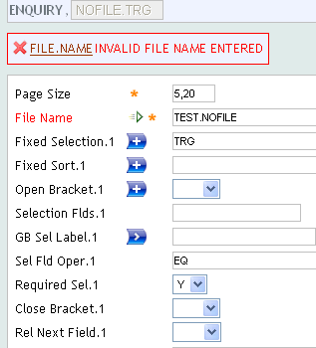
NOFILE – ENQUIRY record
Notes:
After the code is written to extract data, the next step is to create an enquiry record. So now what do you think you should give in the file FILE.NAME? The subroutine you just created has all the data, so can you enter the subroutine name? An error is encountered as this field can hold only a valid STANDARD.SELECTION record ID. So then what do you do? Where can you attach the routine to display the required data?
PRG7-Nofile Enquiry-R12

Slide 24
NOFILE – ENQUIRY record
A valid application name should be given in the field FILE.NAME which is checked against STANDARD.SELECTION (SS) application
A NOFILE enquiry does not have a single associated file
Create a dummy record in STANDARD.SELECTION application
Notes:
To create a record in ENQUIRY application, you need to give a valid T24 application name in the field FILE.NAME. T24 validates the entry in this field by checking for a record in the STANDARD.SELECTION application. The application given in this field is the application on which the enquiry is based.
A Nofile enquiry does not have a single associated file as it extracts data from multiple applications. Then which application name is given in the field FILE.NAME?
Can you leave the field FILE.NAME without inputting any value as it involves multiple applications? Try committing the record without entering any value. System will throw an error as it is a mandatory field and it expects a valid STANDARD.SELECTION ID. If this is the case then what can you do to overcome this situation. Can you create a dummy STANDARD.SELECTION record? Create a STANDARD.SELECTION record with an ID of your choice. Does T24 allow you to do so?
PRG7-Nofile Enquiry-R12

Slide 25
NOFILE – ENQUIRY record
Can you create a record with any ID of your choice in SS?
Checks for a valid FILE.CONTROL entry with the same ID
What could be the way out to overcome these validations in case of a Nofile enquiry?
Notes:
T24 does not allow you to create a record with any ID in SS. Only an application that stores data, will have fields and will have an SS record.
When you try creating a record in SS, T24 will throw an error ‘MISSING FILE.CONTROL - RECORD’. This is because, it looks for a FILE.CONTROL entry with the same ID as in SS. All files that store data in T24 have a FILE.CONTROL record.
So what could be the possible way out to overcome all these validations when it comes to a Nofile enquiry?
PRG7-Nofile Enquiry-R12

Slide 26
NOFILE – ENQUIRY record
ID of the record in SS should be prefixed with ‘NOFILE.’
Does not check for any entries in other applications
Syntax for the ID in SS is NOFILE.<VALIDTEXT>
This ID should be given in the field FILE.NAME in the ENQUIRY application
Notes:
In case of a Nofile enquiry, you just need an SS record whose ID is to be given in the ENQUIRY application. There is no need to have any FILE.CONTROL entry. This can be achieved by prefixing the ID of the record in SS with ‘NOFILE.’.
Once the system notices that the record ID in SS is starting with NOFILE., it understands that this record is specific for Nofile enquiries and therefore does not check for any other valid entries in other applications.
Syntax for the ID in SS application in ‘NOFILE.<VALIDTEXT>’. Example : NOFILE.TEST
The record created in SS with ID starting with NOFILE. is to be given in the field FILE.NAME in the ENQUIRY application.
PRG7-Nofile Enquiry-R12

Slide 27
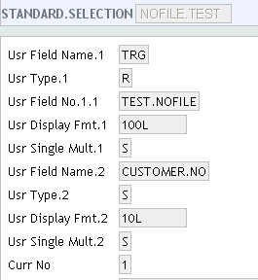
Solution – STANDARD.SELECTION
Notes:
Therefore after writing the code to gather data for the enquiry, you need a SS record to create an enquiry to display the report. As you already know, to create a Nofile enquiry, the SS record name should be prefixed with ‘NOFILE.’
The SS record is used to store the field names and definitions of an application. In a simple enquiry, if you want to display data, you can use a field name from a particular SS record.
In case of a Nofile enquiry, you must define a field in the SS record to hold the data that is returned from the routine. The algorithm is based on the assumption that the end user will input a customer number. Therefore the required field to input customer number and a field to hold the data returned has to be created in SS. All the fields that are created in the SS record are ‘User Defined’.
The field defined to hold data returned should have the field USR.TYPE in SS set to R which stands for a routine and USR.FIELD.NO should hold the routine name.
The field defined to input customer number should have the field USR.TYPE in SS set to S which stands for selection field. A Nofile enquiry can have one or more selection fields that can be input by the user and used within the routine to return values.
PRG7-Nofile Enquiry-R12

Slide 28
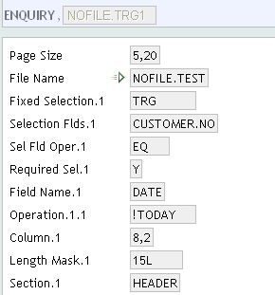
Solution – ENQUIRY
Notes:
Now that you have created an SS record, the last step is to create an ENQUIRY to display the required report. The field FILE.NAME in the enquiry record should hold the SS record name that you have just created. The field FIXED.SELECTION should hold the ‘R’ type field and the field SELECTION.FLDS should hold the ‘S’ type field defined in SS.
All the required header information to be displayed in the report must be defined in the ENQUIRY application.
PRG7-Nofile Enquiry-R12

Slide 29
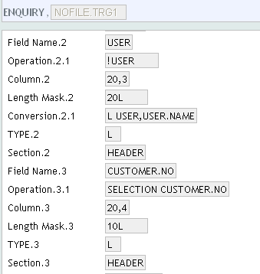
Solution – ENQUIRY
Notes:
The field OPERATION should hold the field number or name from where data is to be picked from the underlying application. Since CUSTOMER.NO is a special selection field defined for the Nofile enquiry, it must be accessed as shown in the screenshot.
PRG7-Nofile Enquiry-R12

Slide 30
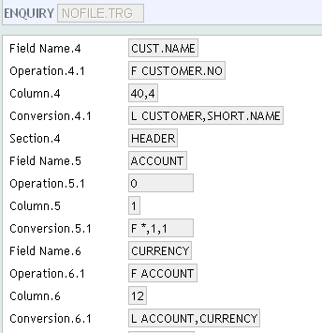
Solution – ENQUIRY
Notes:
The field OPERATION for ACCOUNT is zero because to the ENQUIRY application, the routine has returned a list of ID’s that it is manipulating.
The field CONVERSION has the value F *,1,1 where ‘F’ stands for FIELD, ‘*’ is the delimiter used in the array variable in the subroutine that returns values, ‘1’ stands for which delimiter we are talking about in the string and ‘1’ stands for how many values after the delimiter must be returned.
PRG7-Nofile Enquiry-R12

Slide 31
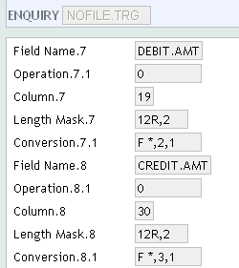
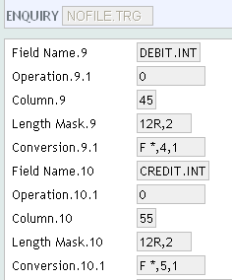
Solution – ENQUIRY
Notes:
The field LENGTH.MASK holds the value 12R,2 where ‘12’ stands for characters maximum, ‘R’ stands for Right justified, ‘,’ stands for comma separated amount and ‘2’ denotes two decimal places. The second and the third field will hold the debit and credit amount and the fourth and fifth field will hold the debit and credit interest respectively.
Note:- For the Title name to be displayed in the output of the enquiry GB Field Lbl field has to filled with required column name for each field.
PRG7-Nofile Enquiry-R12

Slide 32
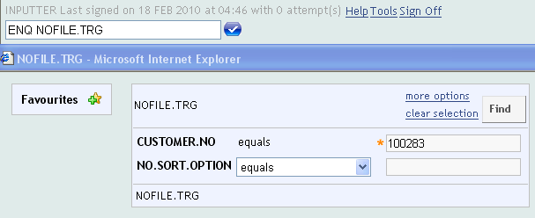
Executing The Enquiry
Notes:
Now that you have created a Nofile enquiry, you can check if the desired report is generated properly. Nofile enquiry can be executed just as a normal enquiry. Type in ENQ <enquiry name> to execute the enquiry and input a customer number.
PRG7-Nofile Enquiry-R12

Slide 33
Enquiry Output
Notes:
You have now successfully generated the required report.
PRG7-Nofile Enquiry-R12

Slide 34
Quiz
QUIZ
Notes:
1.Question : Nofile enquiries require data from a single application in T24
TRUE
FALSE – Multiple applications
2. Question : For Nofile enquires, the name of the record in STANDARD.SELECTION application should be prefixed with NOFILE.
TRUE
FALSE
3. Question : There is no need of an ENQUIRY application to execute a Nofile enquiry
TRUE
FALSE
4. Question : The routine to extract data should have one return variable
TRUE
FALSE
5. Question : D.FIELDS is the common variable which is used to hold the operand used in the selection criteria box.
TRUE
FALSE – D.LOGICAL.OPERANDS
6. Question : The field OPERATION in the ENQUIRY application will hold a value zero while extracting values from the routine
TRUE
FALSE
PRG7-Nofile Enquiry-R12

Slide 35
Nutshell
The routine must have one return variable
Any delimiter (instead of ‘*’) can be used in the routine
Data in the routine must be accumulated row-wise
FM must be the separator in the return variable
The routine should return the list of IDs to the ENQUIRY application
Operation must be 0 while extracting values from a list returned by a subroutine
Use the FIELD conversion utility to extract values
Notes:
1.The routine must have one return variable
2. Any delimiter (instead of ‘*’) can be used in the routine
3. Data in the routine must be accumulated row-wise
4. FM must be the separator in the return variable
5. The routine should return the list of IDs to the ENQUIRY application
6. Operation must be zero while extracting values from a list returned by a subroutine
7. Use the FIELD conversion utility to extract values
PRG7-Nofile Enquiry-R12

Slide 36
Summary
In this learning unit/course, you learnt about the NOFILE ENQUIRIES in T24
You will now be able to:
Create Nofile Enquiries in T24
Execute a Nofile enquriy
Notes:
In this learning unit/course, you learnt about the NOFILE ENQUIRIES in T24
You will now be able to:
Create Nofile Enquiries in T24
Execute a Nofile enquiry
PRG7-Nofile Enquiry-R12

Slide 37
Version History
Authoring Contributions:
Sara Cleur (First Edition, 2005) –Temenos India Private Ltd.
Sara Cleur (Second Edition, October 2007) - Temenos India Private Ltd.
Chaitanya Franklin (Third Edition, September 2008) – Temenos India Private Ltd.
Reena Bhatia (Fourth Edition, March 2010) – Temenos India Private Ltd.
Thankful Acknowledgements:
Temenos Corporate Training Team
Notes:
PRG7-Nofile Enquiry-R12

Slide 38
Thank You
Notes:
PRG7-Nofile Enquiry-R12

